Slide 1

Personal Cloud Storage with AES Encryption
Aniruddh Bhagwat 405B005
Manav Chouhan 405B018
Rohit Kshirsagar 405B036
Prashant Kumar 405B049

Slide 2
Contents
Problem Statement
Objective
Hardware and Software Requirements
Functionalities
Cloud Computing
Soft Computing
Genetic Algorithm
GUI Demo
Conclusion

Slide 3
INTRODUCTION

Slide 4
Problem Statement
To build a personal cloud storage that stores data and ensures its security by encrypting it.

Slide 5
Objectives
To build a personal cloud to store files.
Adding users to it for simultaneous access.
Adding/Deleting folders to the cloud.
Sharing files within users.
Ensure security of files by encrypting them.

Slide 6
Brief Look at Project
Signup
Login
Reset password
Upload files/images/folders(.zip format).
Share files with other users.
Move files to the bin/ restore deleted files.
Download uploaded files anywhere.
File encryption using AES algorithm.
Change personal details.

Slide 7
Proposed System
Login
Upload Files
Share Files
Encrypt Files
Signup
Reset Password
Edit Profile
Upload Images,
Documents,
Videos
With Others,
Download Files remotely
AES algorithm

Slide 8
Hardware and Software Requirements
Hardware Requirements:
Raspberry pi 4 module, battery, connecting wires, charger.
Software Requirements:
Raspbian OS, python3 with pre-installed libraries, text editor, VnC viewer

Slide 9
FUNCTIONALITIES

Slide 10
Functions Performed
The following functions are performed by the system:
Signup: Takes four parameters for registering user.
Name
Email
Password
Phone number
2. Login: Takes two parameters for logging in:
Email
Password
#Option for forgot password---> Sends reset link to email address.

Slide 11
3. Share Files:
Sharing files with the members of common group, helps in saving memory, easy access at one place for all the members. Functionality to delete shared files directly from the page.
4. Encrypt Files:
Contents are encrypted to ensure security of the documents uploaded. We have used AES encryption algorithm for the task.
pyAesCrypt is a Python 3 file-encryption module and script that uses AES256-CBC to encrypt/decrypt files and binary streams.
pyAesCrypt is compatible with the AES Crypt file format (version 2). It is Free Software, released under the Apache License, Version 2.0.

Slide 12
Firebase
Firebase is a platform developed by Google for creating mobile and web applications. It provides developers with a variety of tools and services to help them develop quality apps, grow their user base, and earn profit. It is built on Google's infrastructure. Firebase is categorized as a NoSQL database program, which stores data in JSON-like documents.

Slide 13
Cloud Computing
Cloud computing is the on-demand availability of computer system resources, especially data storage and computing power, without direct active management by the user. The term is generally used to describe data centers available to many users over the Internet.

Slide 14
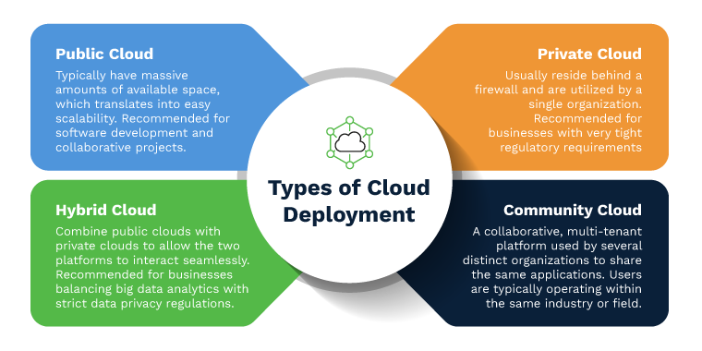

Slide 15
Cloud Service Models
1.SaaS(Software as a Service)
SaaS Model allows to use software applications as a service to end users. It It is a way of delivering services and applications over the internet without installing and maintaining software.
2.PaaS(Platform as a Service)
PaaS delivers a framework for developers that they can build upon and use to create customized applications.
3.IaaS(Infrastructure as a Service)
IaaS is virtual platform on which required operating environment and application are deployed .It includes storage as a service offerings.

Slide 16
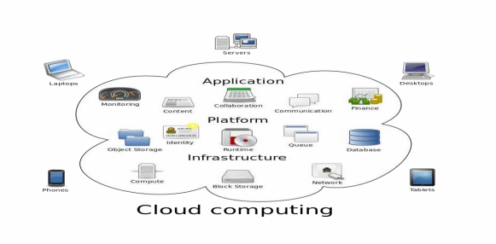

Slide 17
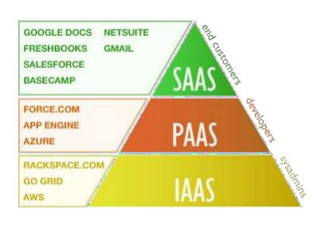

Slide 18
Soft Computing
Soft computing is an emerging approach to computing which parallel the remarkable ability of the human mind to reason and learn in an environment of uncertainty and imprecision. The main goal of soft computing is to develop intelligent machines to provide solutions to real world problems, which are not modelled or too difficult to model mathematically.
Principal Components includes:
Neural Network(NN)
Fuzzy Logic(FL)
Genetic Algorithm(GA)

Slide 19
Neural Networks:
A neural network is a series of algorithms that endeavors to recognize underlying relationships in a set of data through a process that mimics the way the human brain operates. In this sense, neural networks refer to systems of neurons, either organic or artificial in nature.
Fuzzy Logic:
In logic, fuzzy logic is a form of many-valued logic in which the truth value of variables may be any real number between 0 and 1 both inclusive. It is employed to handle the concept of partial truth, where the truth value may range between completely true and completely false.

Slide 20
Genetic Algorithm
Genetic Algorithm (GA) is a search-based optimization technique based on the principles of Genetics and Natural Selection. It is frequently used to find optimal or near-optimal solutions to difficult problems. It maintains a population of candidate solution for the problem at hand , and makes it evolve by iteratively applying a set of stochastic operators.
GA operations-
Initial Population
Fitness Function
Selection
Crossover
Mutation

Slide 21
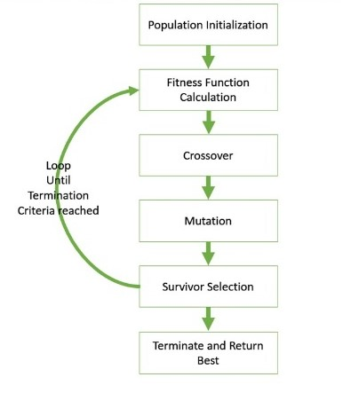
Steps in Genetic Algorithm
Randomly generate an initial population.
Compute and save the fitness for each individual in the current population
Define selection probabilities for each individual.
Generate probabilistically selecting individuals from population to produce offspring via genetic operators.
Repeat step 2 until satisfying solution is obtained.

Slide 22
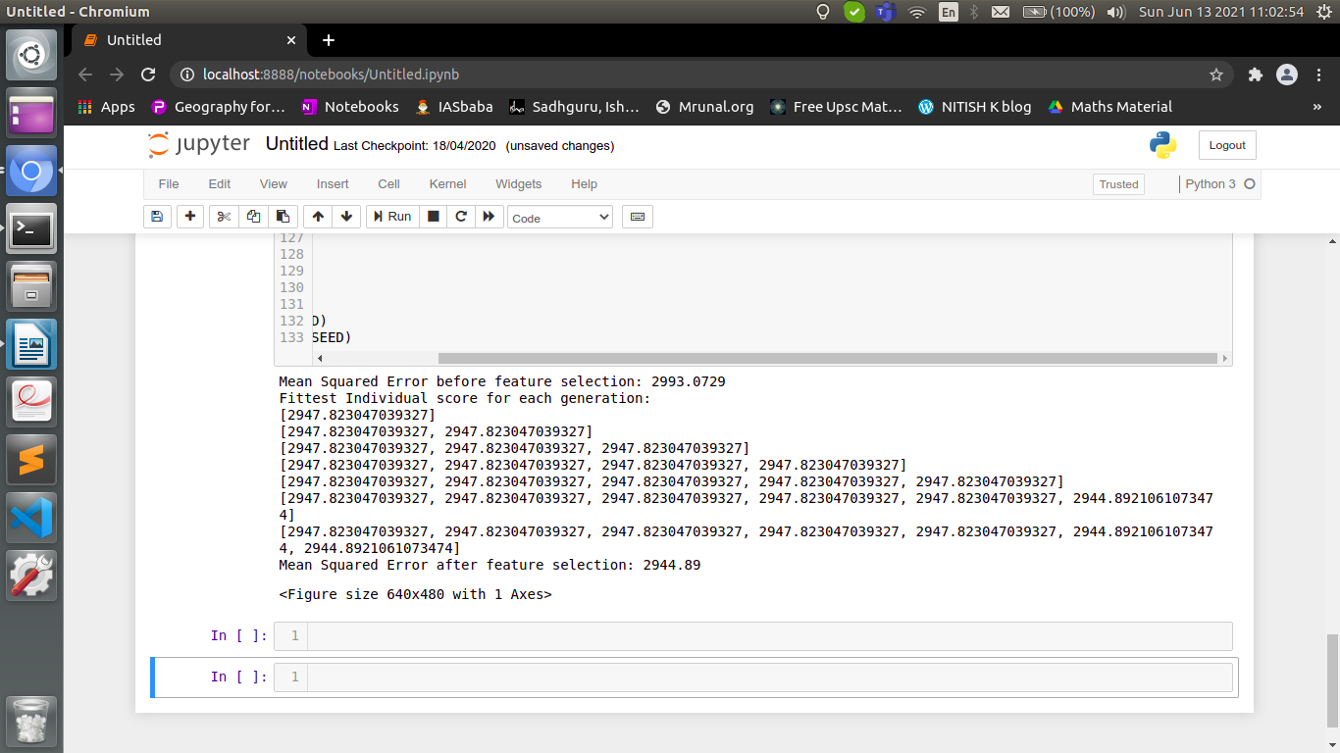

Slide 23
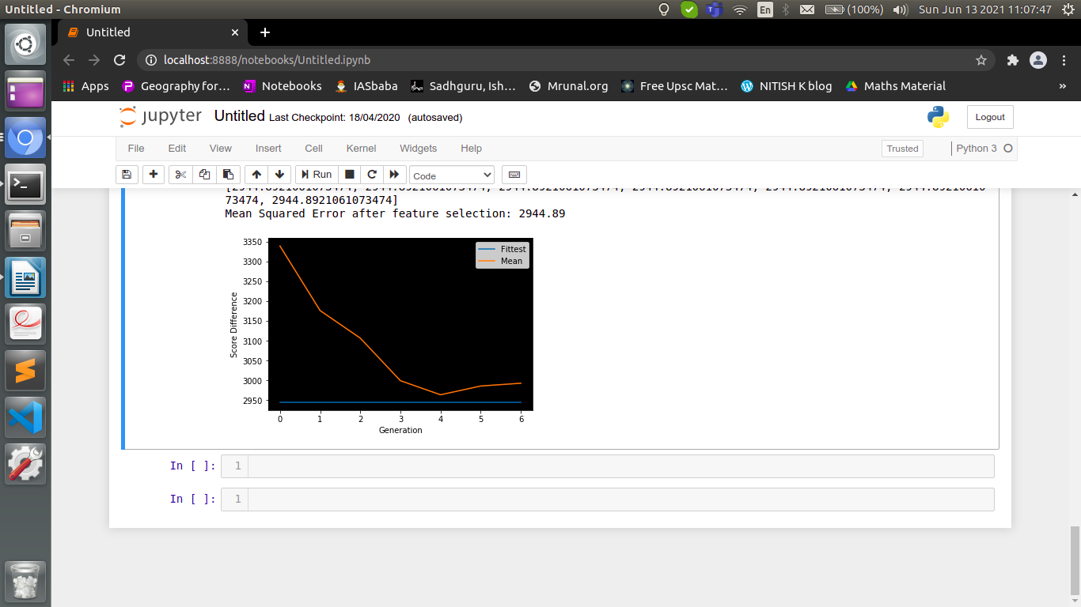

Slide 24
Results and Conclusion
We have implemented personal cloud storage and have encrypted the files to ensure security of the files and used genetic algorithm to minimize optimization problems. A look the GUI of the project:

Slide 25
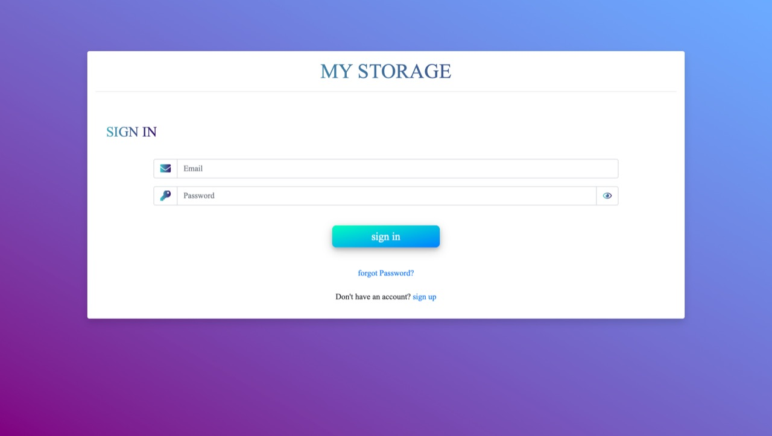

Slide 26
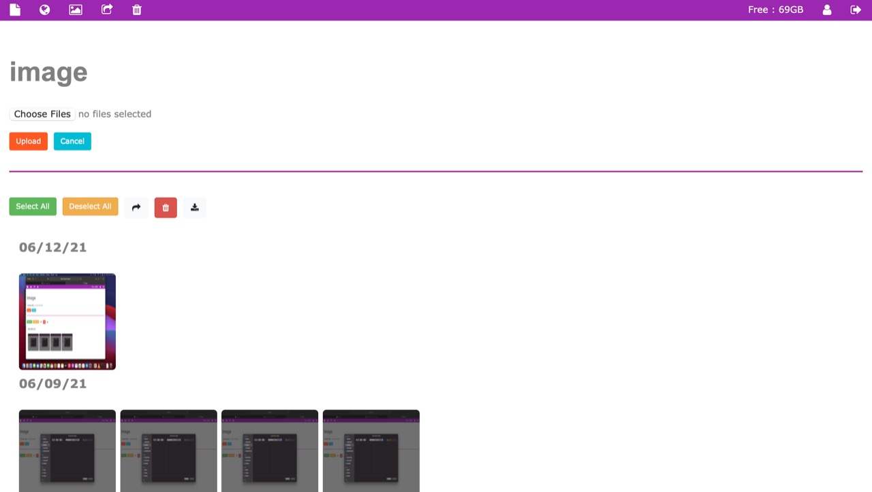

Slide 27
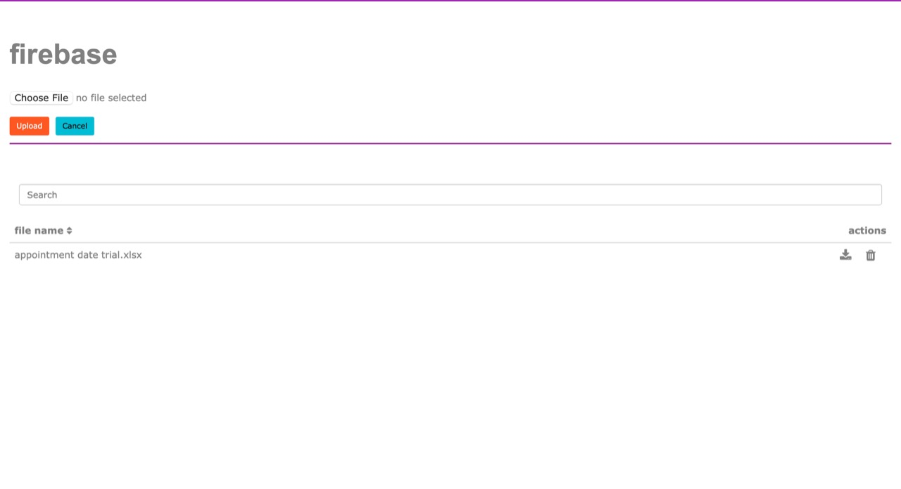

Slide 28
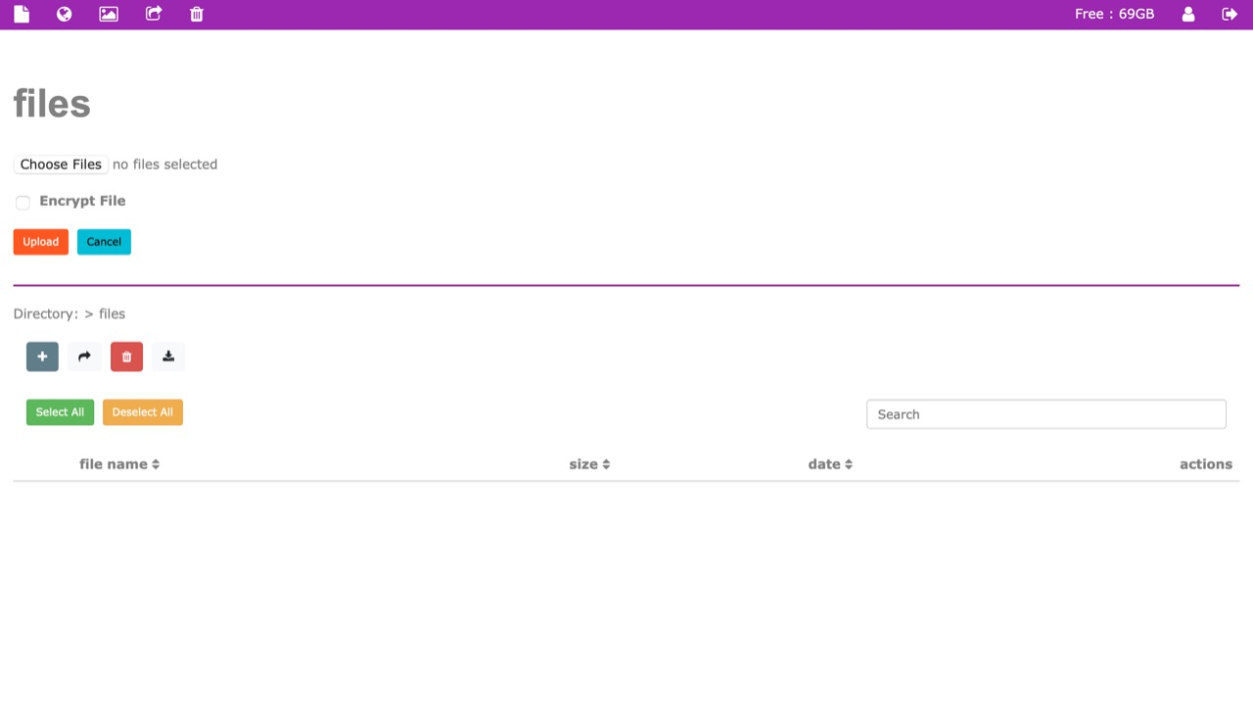

Slide 29
THANK YOU

